Slide 1
IEEE Central Texas Section 2018 Fall Leadership Planning Meeting August 25, 2018 San Marcus, TX
Section Committee/Officer Name: PACE
Chapter/Affinity Name: PACE CTS
Prepared by: Norma Antunano

Slide 2
2018 PACE
Accomplishments:
May Congressional Visit 4 attendees ( Shashil Dalvi, Sunny, Fawzi B., Mina Hanna)
July Future Leaders Forum (normally up to $500 can qualify).
August “Successful Consultant” Workshop (PACE can match up to $500)
2018 PACE Budget:
Annual budget $12500
CVD fund for travel $2400
Future leaders forum $1250 (for ~ 4 registration)
For review:
A bit hard to follow processes, although these may sound simple when reading them (multiple hand offs, fragmented e-locations); multiple emails issued to reach the objective.
Mina submitted expense report (email) but he has not been reimbursed
No visibility if Shashil has submitted his expense report.
Remember to submit fund request in advance to pacechair@ieee5.org, carbon copying (cc) R5pacerequests@gmail.com
PACE report should be submitted within 10 days of conclusion of the event Approved events

Slide 3
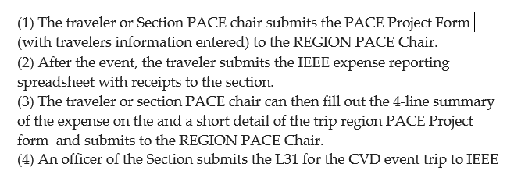
PACE funded activities
Process for submitting PACE funded expense reports:
Per Nasr Ulah, Region 5 Pace Chair

Slide 4
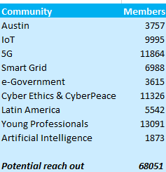
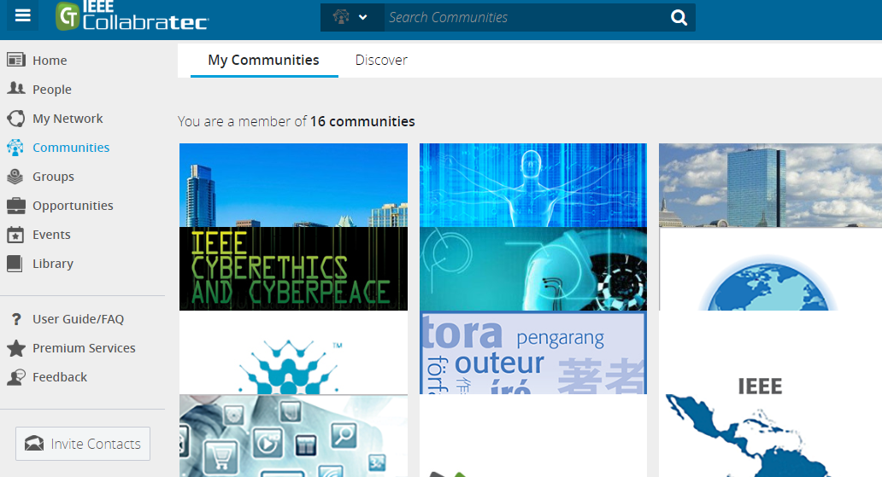
IEEE Collabratec
CTS events are being shared in several Collabratec communities:
https://ieee-collabratec.ieee.org/app/search/communities

